Slide 1
Giới thiệu Về Android, LibGdx
Đỗ Văn Trung

Slide 2
Introduce Android

Slide 3
Introduce libGDX
a cross-platform game development library written in Java
with some JNI code for performance hungry sections.
desktop, Android and HTML5 base on OpenGL
developed entirely on the desktop (then only 6 lines of code to run on Android or HTML5)

Slide 4
Goals & Features
I. General
Cross-platform development for Windows, Linux, OSX and Android.
Multiple backends: Jogl, LWJGL, GWT, Android API
Write and test your application on the desktop, deploy to Android, HTML5.

Slide 5

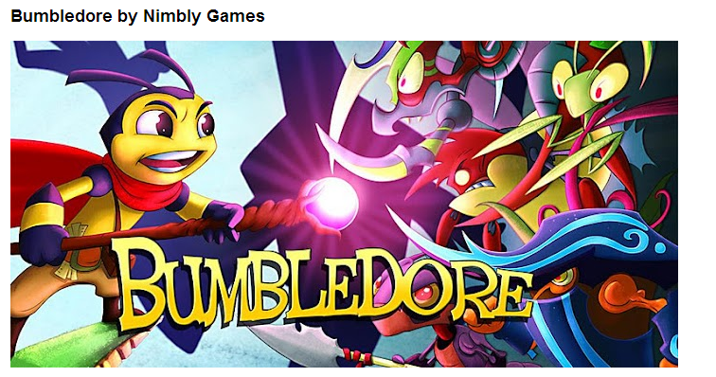
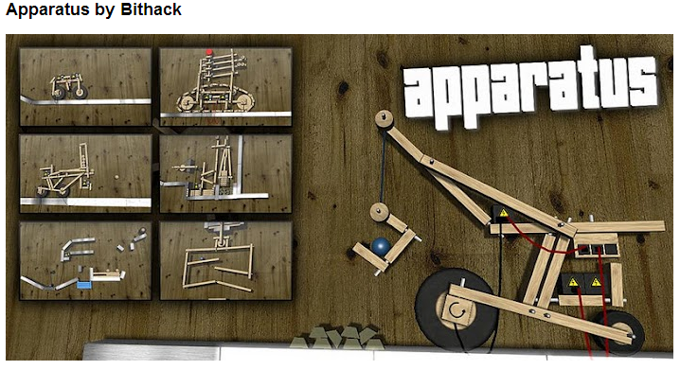
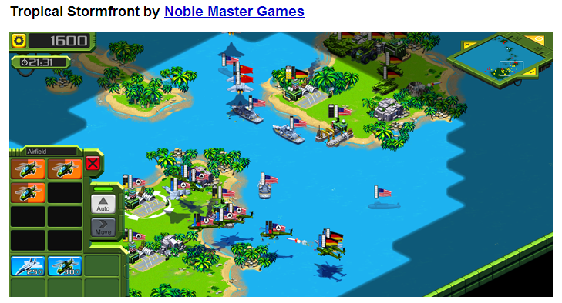
Some game base on libGDX

Slide 6
Other Engines

Slide 8
Prerequisites
JDK
Eclipse
Android SDK and Eclipse ADT Plugin
Google Web Toolkit

Slide 9
LibGdx Setup
Download libgdx.jar at: http://libgdx.badlogicgames.com/nightlies/libgdx-nightly-latest.zip
2 way to set-up:
Use LibGdx-Setup-UI
Manual

Slide 10
libGDX Setup UI
Run jar file: gdx-setup-ui.jar
Specify your project's configuration
Specify the libgdx stable/nightly release zip file
Hit the "Generate projects" button
Import project to Eclipse: File -> Import -> Existing Projects into Workspace

Slide 11
Porject Layout
Core project ("my-gdx-game") Android
project ("my-gdx-game-android")
Desktop project ("my-gdx-game-desktop")
HTML5 project ("my-gdx-game-html")

Slide 12
Running Your Application
Desktop:
Right click the desktop project, Run As -> Java Application.
Select the desktop starter class
Android
Right click Android project, Run As -> Android Application

Slide 13
Manual Setup
Main project setup
Desktop project setup
Android project setup
Asset folder setup
Creating a game
Running the game on the desktop
Running the game on Android

Slide 14
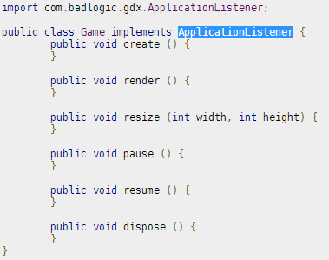
Creating a game
Implements ApplicationListener

Slide 15
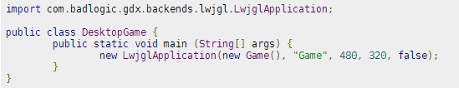
Game on Desktop
Use LwjglApplication or JoglApplication
Lwjgl: Lightweight Java Game Library
Jogl: Java Binding for the OpenGL

Slide 16
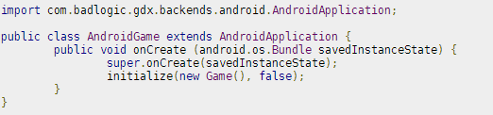
Game on Android

Slide 17
First Program – my-gdx-game
Use libGDX Setup UI.
Contain 4 project:
my-gdx-game: core project. Contain all code of game (except Starter Class, ex: Main(Desktop), Activity(android)...)
my-gdx-game-android: Android project
my-gdx-game-desktop: Destkop project
My-gdx-game-html: HTML5 project

